Slide 1


Ch 7.5: Homogeneous Linear Systems with Constant Coefficients
We consider here a homogeneous system of n first order linear equations with constant, real coefficients:
This system can be written as x' = Ax, where
$$x_{1}^{′}=a_{11}x_{1}+a_{12}x_{2}+…+a_{1n}x_{n} \\ x_{2}^{′}=a_{21}x_{1}+a_{22}x_{2}+…+a_{2n}x_{n} \\ ⋮ \\ x_{n}^{′}=a_{n1}x_{1}+a_{n2}x_{2}+…+a_{nn}x_{n}$$
$$x(t)=\left(\begin{matrix}x_{1}(t) \\ x_{2}(t) \\ ⋮ \\ x_{m}(t)\end{matrix}\right),A=\left(\begin{matrix}a_{11} & a_{12} & ⋯ & a_{1n} \\ a_{21} & a_{22} & ⋯ & a_{2n} \\ ⋮ & ⋮ & ⋱ & ⋮ \\ a_{n1} & a_{n2} & ⋯ & a_{nn}\end{matrix}\right)$$

Slide 2

Equilibrium Solutions
Note that if n = 1, then the system reduces to
Recall that x = 0 is the only equilibrium solution if a ≠ 0.
Further, x = 0 is an asymptotically stable solution if a < 0, since other solutions approach x = 0 in this case.
Also, x = 0 is an unstable solution if a > 0, since other solutions depart from x = 0 in this case.
For n > 1, equilibrium solutions are similarly found by solving Ax = 0. We assume detA ≠ 0, so that x = 0 is the only solution. Determining whether x = 0 is asymptotically stable or unstable is an important question here as well.
$$x^{′}=ax⇒x(t)=e^{at}$$

Slide 3

Phase Plane
When n = 2, then the system reduces to
This case can be visualized in the x₁x₂-plane, which is called the phase plane.
In the phase plane, a direction field can be obtained by evaluating Ax at many points and plotting the resulting vectors, which will be tangent to solution vectors.
A plot that shows representative solution trajectories is called a phase portrait.
Examples of phase planes, directions fields and phase portraits will be given later in this section.
$$x_{1}^{′}=a_{11}x_{1}+a_{12}x_{2} \\ x_{2}^{′}=a_{21}x_{1}+a_{22}x_{2}$$

Slide 4
Solving Homogeneous System
To construct a general solution to x' = Ax, assume a solution of the form x = ξe^{rt}, where the exponent r and the constant vector ξ are to be determined.
Substituting x = ξe^{rt} into x' = Ax, we obtain
Thus to solve the homogeneous system of differential equations x' = Ax, we must find the eigenvalues and eigenvectors of A.
Therefore x = ξe^{rt} is a solution of x' = Ax provided that r is an eigenvalue and ξ is an eigenvector of the coefficient matrix A.
$$rξe^{rt}=Aξe^{rt}⇔rξ=Aξ⇔\left(A−rI\right)ξ=0$$

Slide 5
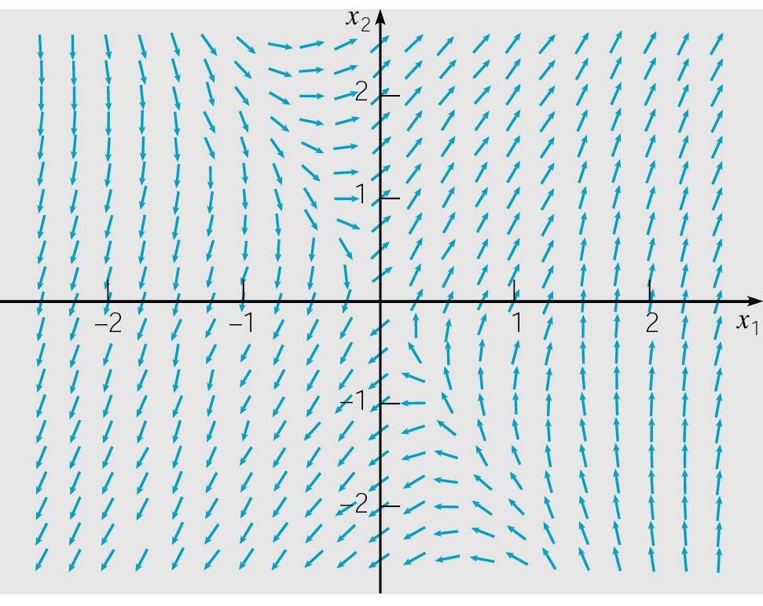

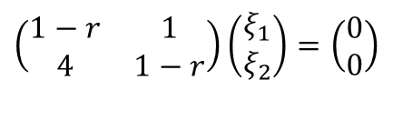
Example 1: Direction Field (1 of 9)
Consider the homogeneous equation x' = Ax below.
A direction field for this system is given below.
Substituting x = ξe^{rt} in for x, and rewriting system as
(A-rI)ξ = 0, we obtain
$$x^{′}=\left(\begin{matrix}1 & 1 \\ 4 & 1\end{matrix}\right)x$$
$$\left(\begin{matrix}1−r & 1 \\ 4 & 1−r\end{matrix}\right)\left(\begin{matrix}ξ_{1} \\ ξ_{2}\end{matrix}\right)=\left(\begin{matrix}0 \\ 0\end{matrix}\right)$$

Slide 6
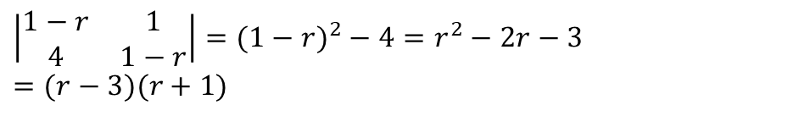
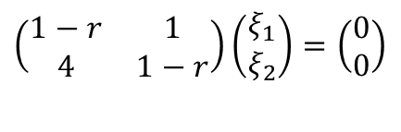
Example 1: Eigenvalues (2 of 9)
Our solution has the form x = ξe^{rt}, where r and ξ are found by solving
Recalling that this is an eigenvalue problem, we determine r by solving det(A-rI) = 0:
Thus r₁ = 3 and r₂ = -1.
$$\left(\begin{matrix}1−r & 1 \\ 4 & 1−r\end{matrix}\right)\left(\begin{matrix}ξ_{1} \\ ξ_{2}\end{matrix}\right)=\left(\begin{matrix}0 \\ 0\end{matrix}\right)$$
$$\left|\begin{matrix}1−r & 1 \\ 4 & 1−r\end{matrix}\right|=(1−r)^{2}−4=r^{2}−2r−3=(r−3)(r+1)$$

Slide 7
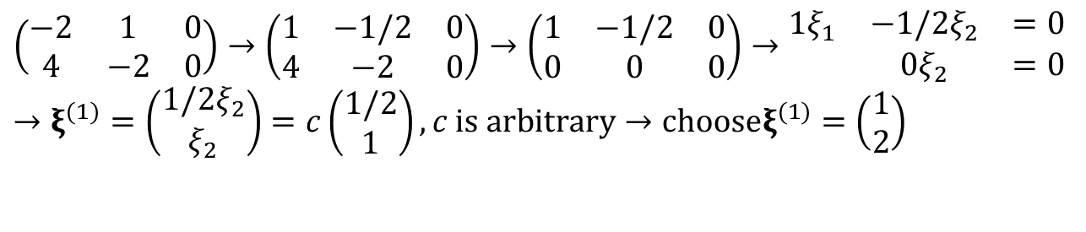
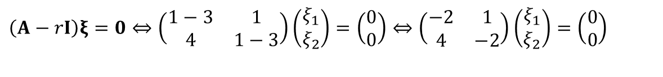
Example 1: First Eigenvector (3 of 9)
Eigenvector for r₁ = 3: Solve
by row reducing the augmented matrix:
$$\left(A−rI\right)ξ=0⇔\left(\begin{matrix}1−3 & 1 \\ 4 & 1−3\end{matrix}\right)\left(\begin{matrix}ξ_{1} \\ ξ_{2}\end{matrix}\right)=\left(\begin{matrix}0 \\ 0\end{matrix}\right)⇔\left(\begin{matrix}−2 & 1 \\ 4 & −2\end{matrix}\right)\left(\begin{matrix}ξ_{1} \\ ξ_{2}\end{matrix}\right)=\left(\begin{matrix}0 \\ 0\end{matrix}\right)$$
$$\left(\begin{matrix}−2 & 1 & 0 \\ 4 & −2 & 0\end{matrix}\right)→\left(\begin{matrix}1 & −1/2 & 0 \\ 4 & −2 & 0\end{matrix}\right)→\left(\begin{matrix}1 & −1/2 & 0 \\ 0 & 0 & 0\end{matrix}\right)→\begin{matrix}1ξ_{1} & −1/2ξ_{2} & =0 \\ & 0ξ_{2} & =0\end{matrix} \\ →ξ^{(1)}=\left(\begin{matrix}1/2ξ_{2} \\ ξ_{2}\end{matrix}\right)=c\left(\begin{matrix}1/2 \\ 1\end{matrix}\right),c \text{is} \text{arbitrary}→\text{choose}ξ^{(1)}=\left(\begin{matrix}1 \\ 2\end{matrix}\right)$$

Slide 8
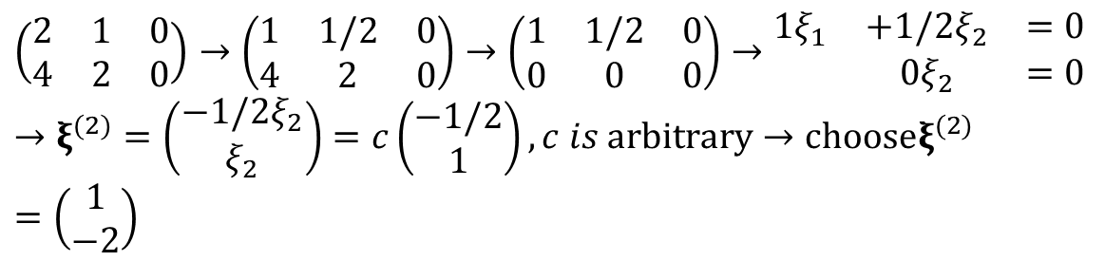
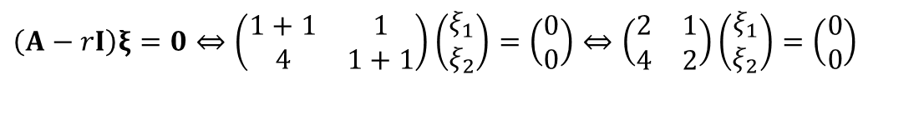
Example 1: Second Eigenvector (4 of 9)
Eigenvector for r₂ = -1: Solve
by row reducing the augmented matrix:
$$\left(A−rI\right)ξ=0⇔\left(\begin{matrix}1+1 & 1 \\ 4 & 1+1\end{matrix}\right)\left(\begin{matrix}ξ_{1} \\ ξ_{2}\end{matrix}\right)=\left(\begin{matrix}0 \\ 0\end{matrix}\right)⇔\left(\begin{matrix}2 & 1 \\ 4 & 2\end{matrix}\right)\left(\begin{matrix}ξ_{1} \\ ξ_{2}\end{matrix}\right)=\left(\begin{matrix}0 \\ 0\end{matrix}\right)$$
$$\left(\begin{matrix}2 & 1 & 0 \\ 4 & 2 & 0\end{matrix}\right)→\left(\begin{matrix}1 & 1/2 & 0 \\ 4 & 2 & 0\end{matrix}\right)→\left(\begin{matrix}1 & 1/2 & 0 \\ 0 & 0 & 0\end{matrix}\right)→\begin{matrix}1ξ_{1} & +1/2ξ_{2} & =0 \\ & 0ξ_{2} & =0\end{matrix} \\ →ξ^{(2)}=\left(\begin{matrix}−1/2ξ_{2} \\ ξ_{2}\end{matrix}\right)=c\left(\begin{matrix}−1/2 \\ 1\end{matrix}\right),c is \text{arbitrary}→\text{choose}ξ^{(2)}=\left(\begin{matrix}1 \\ −2\end{matrix}\right)$$

Slide 9
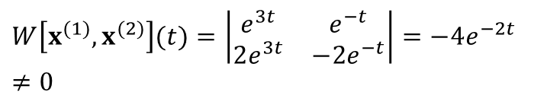
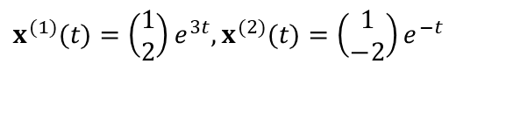
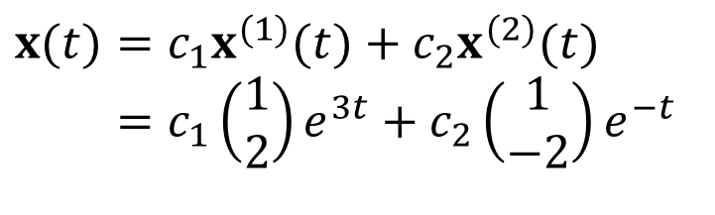
Example 1: General Solution (5 of 9)
The corresponding solutions x = ξe^{rt} of x' = Ax are
The Wronskian of these two solutions is
Thus x⁽¹⁾ and x⁽²⁾ are fundamental solutions, and the general solution of x' = Ax is
$$x^{(1)}(t)=\left(\begin{matrix}1 \\ 2\end{matrix}\right)e^{3t},x^{(2)}(t)=\left(\begin{matrix}1 \\ −2\end{matrix}\right)e^{−t}$$
$$W\left[x^{(1)},x^{(2)}\right](t)=\left|\begin{matrix}e^{3t} & e^{−t} \\ 2e^{3t} & −2e^{−t}\end{matrix}\right|=−4e^{−2t}≠0$$
$$x(t)=c_{1}x^{(1)}(t)+c_{2}x^{(2)}(t) \\ =c_{1}\left(\begin{matrix}1 \\ 2\end{matrix}\right)e^{3t}+c_{2}\left(\begin{matrix}1 \\ −2\end{matrix}\right)e^{−t}$$

Slide 10
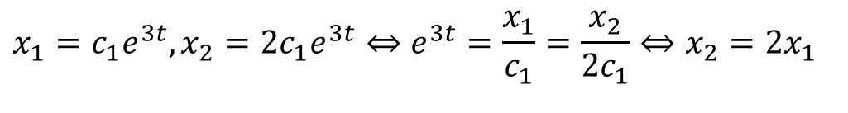
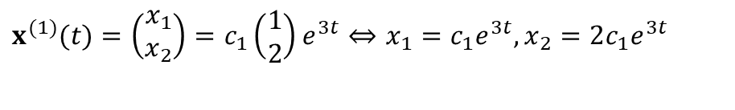
Example 1: Phase Plane for x⁽¹⁾ (6 of 9)
To visualize solution, consider first x = c₁x⁽¹⁾:
Now
Thus x⁽¹⁾ lies along the straight line x₂ = 2x₁, which is the line through origin in direction of first eigenvector ξ⁽¹⁾
If solution is trajectory of particle, with position given by
(x₁, x₂), then it is in Q1 when c₁ > 0, and in Q3 when c₁ < 0.
In either case, particle moves away from origin as t increases.
$$x^{(1)}(t)=\left(\begin{matrix}x_{1} \\ x_{2}\end{matrix}\right)=c_{1}\left(\begin{matrix}1 \\ 2\end{matrix}\right)e^{3t}⇔x_{1}=c_{1}e^{3t},x_{2}=2c_{1}e^{3t}$$
$$x_{1}=c_{1}e^{3t},x_{2}=2c_{1}e^{3t}⇔e^{3t}=\frac{x_{1}}{c_{1}}=\frac{x_{2}}{2c_{1}}⇔x_{2}=2x_{1}$$

Slide 11
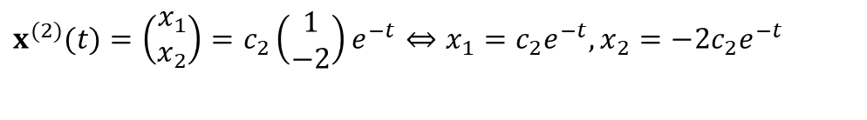
Example 1: Phase Plane for x⁽²⁾ (7 of 9)
Next, consider x = c₂x⁽²⁾:
Then x⁽²⁾ lies along the straight line x₂ = -2x₁, which is the line through origin in direction of 2nd eigenvector ξ⁽²⁾
If solution is trajectory of particle, with position given by (x₁, x₂), then it is in Q4 when c₂ > 0, and in Q2 when c₂ < 0.
In either case, particle moves towards origin as t increases.
$$x^{(2)}(t)=\left(\begin{matrix}x_{1} \\ x_{2}\end{matrix}\right)=c_{2}\left(\begin{matrix}1 \\ −2\end{matrix}\right)e^{−t}⇔x_{1}=c_{2}e^{−t},x_{2}=−2c_{2}e^{−t}$$

Slide 12
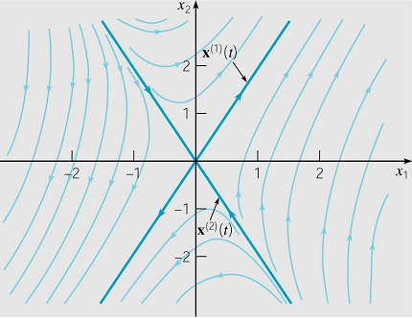
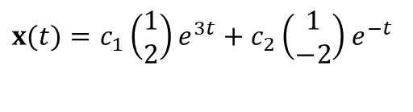
Example 1: Phase Plane for General Solution (8 of 9)
The general solution is x = c₁x⁽¹⁾ + c₂x⁽²⁾:
As t → ∞, c₁x⁽¹⁾ is dominant and c₂x⁽²⁾ becomes negligible. Thus, for c₁ ≠ 0, all solutions asymptotically approach the line x₂ = 2x₁ as t → ∞.
Similarly, for c₂ ≠ 0, all solutions asymptotically approach the line x₂ = -2x₁ as t → - ∞.
The origin is a saddle point,
and is unstable. See graph.
$$x(t)=c_{1}\left(\begin{matrix}1 \\ 2\end{matrix}\right)e^{3t}+c_{2}\left(\begin{matrix}1 \\ −2\end{matrix}\right)e^{−t}$$

Slide 13
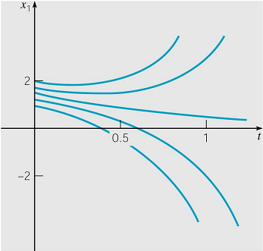
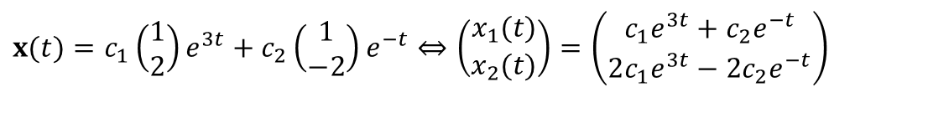
Example 1: Time Plots for General Solution (9 of 9)
The general solution is x = c₁x⁽¹⁾ + c₂x⁽²⁾:
As an alternative to phase plane plots, we can graph x₁ or x₂ as a function of t. A few plots of x₁ are given below.
Note that when c₁ = 0, x₁(t) = c₂e^{-t} → 0 as t → ∞. Otherwise, x₁(t) = c₁e^{3t} + c₂e^{-t} grows unbounded as t → ∞.
Graphs of x₂ are similarly obtained.
$$x(t)=c_{1}\left(\begin{matrix}1 \\ 2\end{matrix}\right)e^{3t}+c_{2}\left(\begin{matrix}1 \\ −2\end{matrix}\right)e^{−t}⇔\left(\begin{matrix}x_{1}(t) \\ x_{2}(t)\end{matrix}\right)=\left(\begin{matrix}c_{1}e^{3t}+c_{2}e^{−t} \\ 2c_{1}e^{3t}−2c_{2}e^{−t}\end{matrix}\right)$$

Slide 14
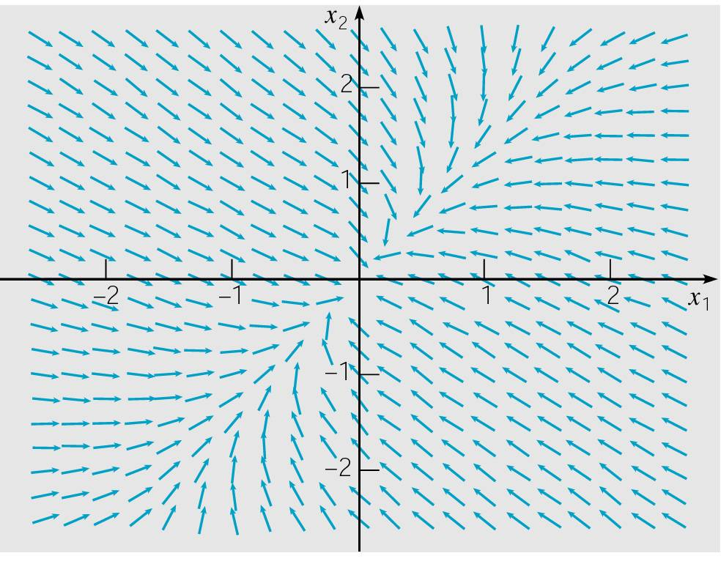
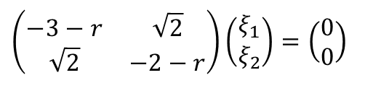

Example 2: (1 of 9)
Consider the homogeneous equation x' = Ax below.
Substituting x = ξe^{rt} in for x, and rewriting system as
(A-rI)ξ = 0, we obtain
$$x^{′}=\left(\begin{matrix}−3 & \sqrt{2} \\ \sqrt{2} & −2\end{matrix}\right)x$$
$$\left(\begin{matrix}−3−r & \sqrt{2} \\ \sqrt{2} & −2−r\end{matrix}\right)\left(\begin{matrix}ξ_{1} \\ ξ_{2}\end{matrix}\right)=\left(\begin{matrix}0 \\ 0\end{matrix}\right)$$

Slide 15
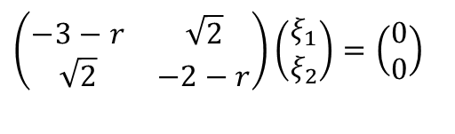
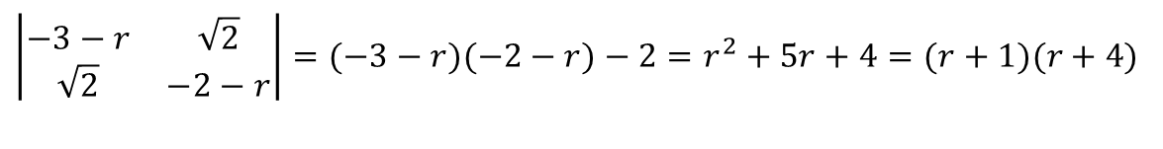
Example 2: Eigenvalues (2 of 9)
Our solution has the form x = ξe^{rt}, where r and ξ are found by solving
Recalling that this is an eigenvalue problem, we determine r by solving det(A-rI) = 0:
Thus r₁ = -1 and r₂ = -4.
$$\left(\begin{matrix}−3−r & \sqrt{2} \\ \sqrt{2} & −2−r\end{matrix}\right)\left(\begin{matrix}ξ_{1} \\ ξ_{2}\end{matrix}\right)=\left(\begin{matrix}0 \\ 0\end{matrix}\right)$$
$$\left|\begin{matrix}−3−r & \sqrt{2} \\ \sqrt{2} & −2−r\end{matrix}\right|=(−3−r)(−2−r)−2=r^{2}+5r+4=(r+1)(r+4)$$

Slide 16
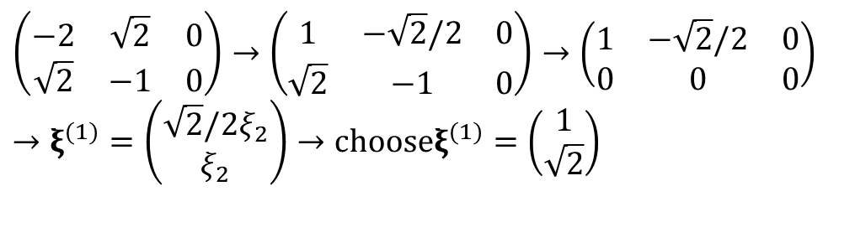
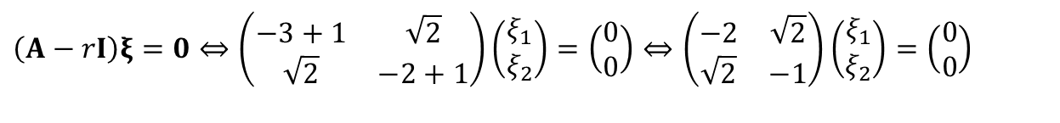
Example 2: First Eigenvector (3 of 9)
Eigenvector for r₁ = -1: Solve
by row reducing the augmented matrix:
$$\left(A−rI\right)ξ=0⇔\left(\begin{matrix}−3+1 & \sqrt{2} \\ \sqrt{2} & −2+1\end{matrix}\right)\left(\begin{matrix}ξ_{1} \\ ξ_{2}\end{matrix}\right)=\left(\begin{matrix}0 \\ 0\end{matrix}\right)⇔\left(\begin{matrix}−2 & \sqrt{2} \\ \sqrt{2} & −1\end{matrix}\right)\left(\begin{matrix}ξ_{1} \\ ξ_{2}\end{matrix}\right)=\left(\begin{matrix}0 \\ 0\end{matrix}\right)$$
$$\left(\begin{matrix}−2 & \sqrt{2} & 0 \\ \sqrt{2} & −1 & 0\end{matrix}\right)→\left(\begin{matrix}1 & −\sqrt{2}/2 & 0 \\ \sqrt{2} & −1 & 0\end{matrix}\right)→\left(\begin{matrix}1 & −\sqrt{2}/2 & 0 \\ 0 & 0 & 0\end{matrix}\right) \\ →ξ^{(1)}=\left(\begin{matrix}\sqrt{2}/2ξ_{2} \\ ξ_{2}\end{matrix}\right)→\text{choose}ξ^{(1)}=\left(\begin{matrix}1 \\ \sqrt{2}\end{matrix}\right)$$

Slide 17

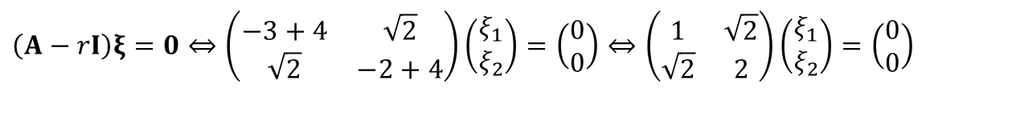
Example 2: Second Eigenvector (4 of 9)
Eigenvector for r₂ = -4: Solve
by row reducing the augmented matrix:
$$\left(A−rI\right)ξ=0⇔\left(\begin{matrix}−3+4 & \sqrt{2} \\ \sqrt{2} & −2+4\end{matrix}\right)\left(\begin{matrix}ξ_{1} \\ ξ_{2}\end{matrix}\right)=\left(\begin{matrix}0 \\ 0\end{matrix}\right)⇔\left(\begin{matrix}1 & \sqrt{2} \\ \sqrt{2} & 2\end{matrix}\right)\left(\begin{matrix}ξ_{1} \\ ξ_{2}\end{matrix}\right)=\left(\begin{matrix}0 \\ 0\end{matrix}\right)$$
$$\left(\begin{matrix}1 & \sqrt{2} & 0 \\ \sqrt{2} & 2 & 0\end{matrix}\right)→\left(\begin{matrix}1 & \sqrt{2} & 0 \\ 0 & 0 & 0\end{matrix}\right)→ξ^{(2)}=\left(\begin{matrix}−\sqrt{2}ξ_{2} \\ ξ_{2}\end{matrix}\right) \\ →\text{choose}ξ^{(2)}=\left(\begin{matrix}−\sqrt{2} \\ 1\end{matrix}\right)$$

Slide 18
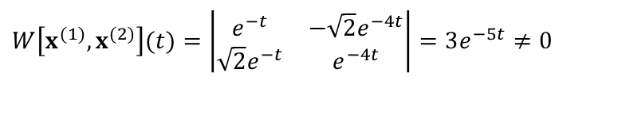
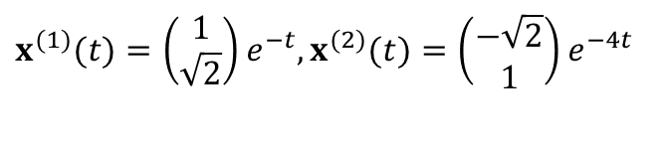
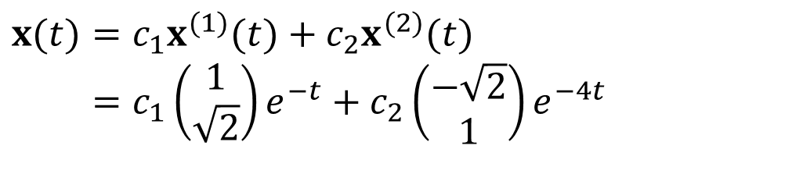
Example 2: General Solution (5 of 9)
The corresponding solutions x = ξe^{rt} of x' = Ax are
The Wronskian of these two solutions is
Thus x⁽¹⁾ and x⁽²⁾ are fundamental solutions, and the general solution of x' = Ax is
$$x^{(1)}(t)=\left(\begin{matrix}1 \\ \sqrt{2}\end{matrix}\right)e^{−t},x^{(2)}(t)=\left(\begin{matrix}−\sqrt{2} \\ 1\end{matrix}\right)e^{−4t}$$
$$W\left[x^{(1)},x^{(2)}\right](t)=\left|\begin{matrix}e^{−t} & −\sqrt{2}e^{−4t} \\ \sqrt{2}e^{−t} & e^{−4t}\end{matrix}\right|=3e^{−5t}≠0$$
$$x(t)=c_{1}x^{(1)}(t)+c_{2}x^{(2)}(t) \\ =c_{1}\left(\begin{matrix}1 \\ \sqrt{2}\end{matrix}\right)e^{−t}+c_{2}\left(\begin{matrix}−\sqrt{2} \\ 1\end{matrix}\right)e^{−4t}$$

Slide 19
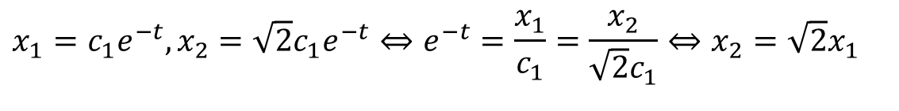
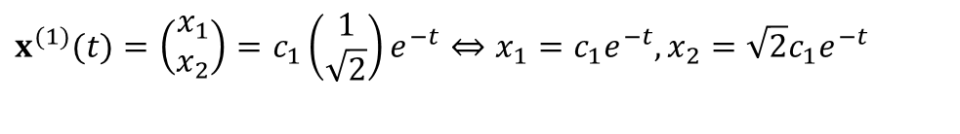
Example 2: Phase Plane for x⁽¹⁾ (6 of 9)
To visualize solution, consider first x = c₁x⁽¹⁾:
Now
Thus x⁽¹⁾ lies along the straight line x₂ = 2^{½} x₁, which is the line through origin in direction of first eigenvector ξ⁽¹⁾
If solution is trajectory of particle, with position given by (x₁, x₂), then it is in Q1 when c₁ > 0, and in Q3 when c₁ < 0.
In either case, particle moves towards origin as t increases.
$$x^{(1)}(t)=\left(\begin{matrix}x_{1} \\ x_{2}\end{matrix}\right)=c_{1}\left(\begin{matrix}1 \\ \sqrt{2}\end{matrix}\right)e^{−t}⇔x_{1}=c_{1}e^{−t},x_{2}=\sqrt{2}c_{1}e^{−t}$$
$$x_{1}=c_{1}e^{−t},x_{2}=\sqrt{2}c_{1}e^{−t}⇔e^{−t}=\frac{x_{1}}{c_{1}}=\frac{x_{2}}{\sqrt{2}c_{1}}⇔x_{2}=\sqrt{2}x_{1}$$

Slide 20
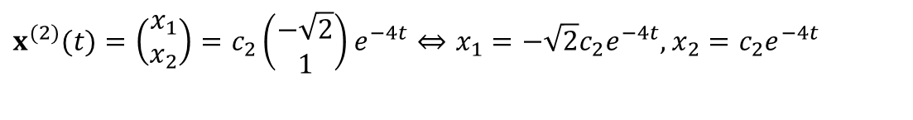
Example 2: Phase Plane for x⁽²⁾ (7 of 9)
Next, consider x = c₂x⁽²⁾:
Then x⁽²⁾ lies along the straight line x₂ = -2^{½} x₁, which is the line through origin in direction of 2nd eigenvector ξ⁽²⁾
If solution is trajectory of particle, with position given by
(x₁, x₂), then it is in Q4 when c₂ > 0, and in Q2 when c₂ < 0.
In either case, particle moves towards origin as t increases.
$$x^{(2)}(t)=\left(\begin{matrix}x_{1} \\ x_{2}\end{matrix}\right)=c_{2}\left(\begin{matrix}−\sqrt{2} \\ 1\end{matrix}\right)e^{−4t}⇔x_{1}=−\sqrt{2}c_{2}e^{−4t},x_{2}=c_{2}e^{−4t}$$

Slide 21
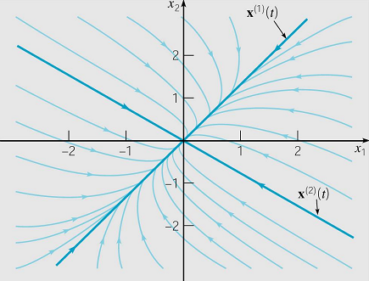
Example 2: Phase Plane for General Solution (8 of 9)
The general solution is x = c₁x⁽¹⁾ + c₂x⁽²⁾:
As t → ∞, c₁x⁽¹⁾ is dominant and c₂x⁽²⁾ becomes negligible. Thus, for c₁ ≠ 0, all solutions asymptotically approach origin along the line x₂ = 2^{½} x₁ as t → ∞.
Similarly, all solutions are unbounded as t → - ∞.
The origin is a node, and is asymptotically stable.
$$x^{(1)}(t)=\left(\begin{matrix}1 \\ \sqrt{2}\end{matrix}\right)e^{−t},x^{(2)}(t)=\left(\begin{matrix}−\sqrt{2} \\ 1\end{matrix}\right)e^{−4t}$$

Slide 22
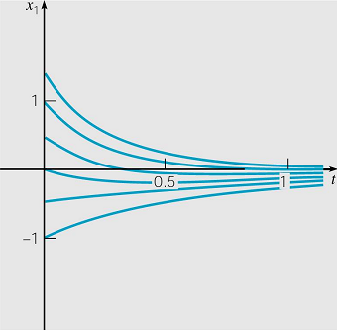
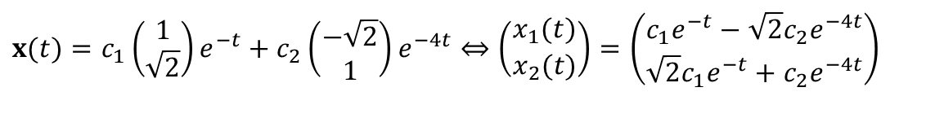
Example 2: Time Plots for General Solution (9 of 9)
The general solution is x = c₁x⁽¹⁾ + c₂x⁽²⁾:
As an alternative to phase plane plots, we can graph x₁ or x₂ as a function of t. A few plots of x₁ are given below.
Graphs of x₂ are similarly obtained.
$$x(t)=c_{1}\left(\begin{matrix}1 \\ \sqrt{2}\end{matrix}\right)e^{−t}+c_{2}\left(\begin{matrix}−\sqrt{2} \\ 1\end{matrix}\right)e^{−4t}⇔\left(\begin{matrix}x_{1}(t) \\ x_{2}(t)\end{matrix}\right)=\left(\begin{matrix}c_{1}e^{−t}−\sqrt{2}c_{2}e^{−4t} \\ \sqrt{2}c_{1}e^{−t}+c_{2}e^{−4t}\end{matrix}\right)$$

Slide 23
2 x 2 Case: Real Eigenvalues, Saddle Points and Nodes
The previous two examples demonstrate the two main cases for a 2 x 2 real system with real and different eigenvalues:
Both eigenvalues have opposite signs, in which case origin is a saddle point and is unstable.
Both eigenvalues have the same sign, in which case origin is a node, and is asymptotically stable if the eigenvalues are negative and unstable if the eigenvalues are positive.

Slide 24


Eigenvalues, Eigenvectors and Fundamental Solutions
In general, for an n x n real linear system x' = Ax:
All eigenvalues are real and different from each other.
Some eigenvalues occur in complex conjugate pairs.
Some eigenvalues are repeated.
If eigenvalues r₁,…, r_{n} are real & different, then there are n corresponding linearly independent eigenvectors ξ⁽¹⁾,…, ξ^{(n)}. The associated solutions of x' = Ax are
Using Wronskian, it can be shown that these solutions are linearly independent, and hence form a fundamental set of solutions. Thus general solution is
$$x^{(1)}(t)=ξ^{(1)}e^{r_{1}t},…,x^{(n)}(t)=ξ^{(n)}e^{r_{n}t}$$
$$x=c_{1}ξ^{(1)}e^{r_{1}t}+…+c_{n}ξ^{(n)}e^{r_{n}t}$$

Slide 25

Hermitian Case: Eigenvalues, Eigenvectors & Fundamental Solutions
If A is an n x n Hermitian matrix (real and symmetric), then all eigenvalues r₁,…, r_{n} are real, although some may repeat.
In any case, there are n corresponding linearly independent and orthogonal eigenvectors ξ⁽¹⁾,…, ξ^{(n)}. The associated solutions of x' = Ax are
and form a fundamental set of solutions.
$$x^{(1)}(t)=ξ^{(1)}e^{r_{1}t},…,x^{(n)}(t)=ξ^{(n)}e^{r_{n}t}$$

Slide 26


Example 3: Hermitian Matrix (1 of 3)
Consider the homogeneous equation x' = Ax below.
The eigenvalues were found in Ch 7.3, and were: r₁ = 2, r₂ = -1 and r₃ = -1.
Corresponding eigenvectors:
$$x^{′}=\left(\begin{matrix}0 & 1 & 1 \\ 1 & 0 & 1 \\ 1 & 1 & 0\end{matrix}\right)x$$
$$ξ^{(1)}=\left(\begin{matrix}1 \\ 1 \\ 1\end{matrix}\right),ξ^{(2)}=\left(\begin{matrix}1 \\ 0 \\ −1\end{matrix}\right)\text{ ,}ξ^{(3)}=\left(\begin{matrix}0 \\ 1 \\ −1\end{matrix}\right)$$

Slide 27
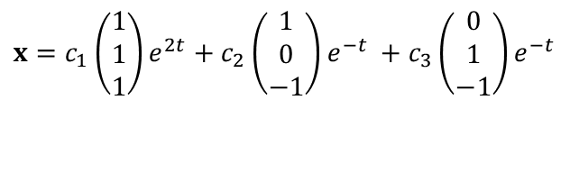
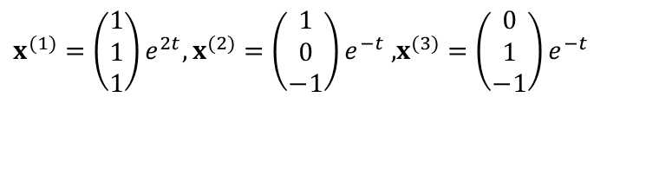
Example 3: General Solution (2 of 3)
The fundamental solutions are
with general solution
$$x^{(1)}=\left(\begin{matrix}1 \\ 1 \\ 1\end{matrix}\right)e^{2t},x^{(2)}=\left(\begin{matrix}1 \\ 0 \\ −1\end{matrix}\right)e^{−t}\text{ ,}x^{(3)}=\left(\begin{matrix}0 \\ 1 \\ −1\end{matrix}\right)e^{−t}$$
$$x=c_{1}\left(\begin{matrix}1 \\ 1 \\ 1\end{matrix}\right)e^{2t}+c_{2}\left(\begin{matrix}1 \\ 0 \\ −1\end{matrix}\right)e^{−t} +c_{3}\left(\begin{matrix}0 \\ 1 \\ −1\end{matrix}\right)e^{−t}$$

Slide 28
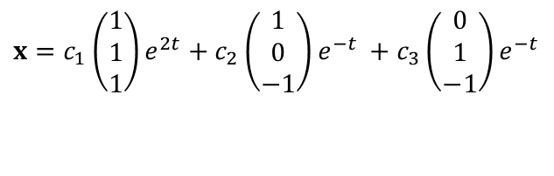
Example 3: General Solution Behavior (3 of 3)
The general solution is x = c₁x⁽¹⁾ + c₂x⁽²⁾ + c₃x⁽³⁾:
As t → ∞, c₁x⁽¹⁾ is dominant and c₂x⁽²⁾ , c₃x⁽³⁾ become negligible.
Thus, for c₁ ≠ 0, all solns x become unbounded as t → ∞,
while for c₁ = 0, all solns x → 0 as t → ∞.
The initial points that cause c₁ = 0 are those that lie in plane determined by ξ⁽²⁾ and ξ⁽³⁾. Thus solutions that start in this plane approach origin as t → ∞.
$$x=c_{1}\left(\begin{matrix}1 \\ 1 \\ 1\end{matrix}\right)e^{2t}+c_{2}\left(\begin{matrix}1 \\ 0 \\ −1\end{matrix}\right)e^{−t} +c_{3}\left(\begin{matrix}0 \\ 1 \\ −1\end{matrix}\right)e^{−t}$$

Slide 29

Complex Eigenvalues and Fundamental Solns
If some of the eigenvalues r₁,…, r_{n} occur in complex conjugate pairs, but otherwise are different, then there are still n corresponding linearly independent solutions
which form a fundamental set of solutions. Some may be complex-valued, but real-valued solutions may be derived from them. This situation will be examined in Ch 7.6.
If the coefficient matrix A is complex, then complex eigenvalues need not occur in conjugate pairs, but solutions will still have the above form (if the eigenvalues are distinct) and these solutions may be complex-valued.
$$x^{(1)}(t)=ξ^{(1)}e^{r_{1}t},…,x^{(n)}(t)=ξ^{(n)}e^{r_{n}t},$$

Slide 30


Repeated Eigenvalues and Fundamental Solns
If some of the eigenvalues r₁,…, r_{n} are repeated, then there may not be n corresponding linearly independent solutions of the form
In order to obtain a fundamental set of solutions, it may be necessary to seek additional solutions of another form.
This situation is analogous to that for an nth order linear equation with constant coefficients, in which case a repeated root gave rise solutions of the form
This case of repeated eigenvalues is examined in Section 7.8.
$$x^{(1)}(t)=ξ^{(1)}e^{r_{1}t},…,x^{(n)}(t)=ξ^{(n)}e^{r_{n}t}$$
$$e^{rt},te^{rt},t^{2}e^{rt},…$$

